Slide 1
Supervised and unsupervised examples
Regression
k-means clustering

Slide 2
Introduction to Regression
Regression analysis is the part of statistics that investigates the relationship between two or more variables related in a nondeterministic fashion.
Linear regression attempts to model the relationship between two variables by fitting a linear equation to observed data.
One variable is considered to be an explanatory variable, and the other is considered to be a dependent variable.
For example, a modeler might want to relate the weights of individuals to their heights using a linear regression model.
Before attempting to fit a linear model to observed data, a modeler should first determine whether or not there is a relationship between the variables of interest.

Slide 3
Introduction to Linear Regression
This does not necessarily imply that one variable causes the other (for example, higher SAT scores do not cause higher college grades), but that there is some significant association between the two variables
A scatterplot can be a helpful tool in determining the strength of the relationship between two variables.
If there appears to be no association between the proposed explanatory and dependent variables (i.e., the scatterplot does not indicate any increasing or decreasing trends), then fitting a linear regression model to the data probably will not provide a useful model.

Slide 4
Introduction to Linear Regression
The simplest deterministic mathematical relationship between two variables x and y is a linear relationship.
y =b₀ + b₁x
The set of pairs (x, y) for which determines a straight line with slope b₁ and y-intercept b₀.
More generally, the denoted by x and will be called the independent, predictor, or explanatory variable.
For fixed x, the second variable will be random; we denote this random variable and its observed value by Y and y, respectively, and refer to it as the dependent or response variable.

Slide 5
Introduction to Linear Regression
Usually observations will be made for a number of settings of the independent variable.
Let x₁, x₂, ….. , x_{n} denote values of the independent variable for which observations are made, and let Y_{i} and y_{i} , respectively, denote the random variable and observed value associated with.
The available bivariate data then consists of the n pairs
(x₁, y₁), (x₂, y₂), ……, (x_{n}, y_{n}).
A picture of this data called a scatter plot gives preliminary impressions about the nature of any relationship.
In such a plot, each (x_{i}, y_{i}) is represented as a point plotted on a two-dimensional coordinate system.

Slide 6
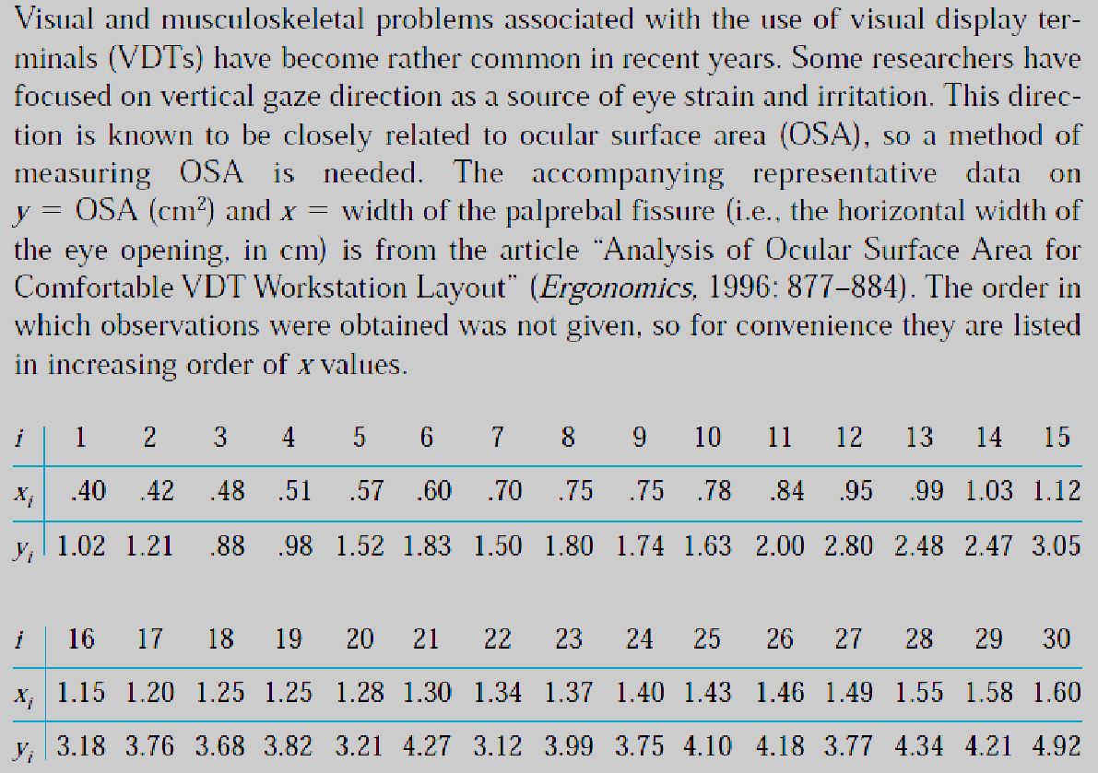
Scatter Plot Example: Linear Regression
Credits: Probability and Statistics for Engineering and the Science by Jan Devore

Slide 7
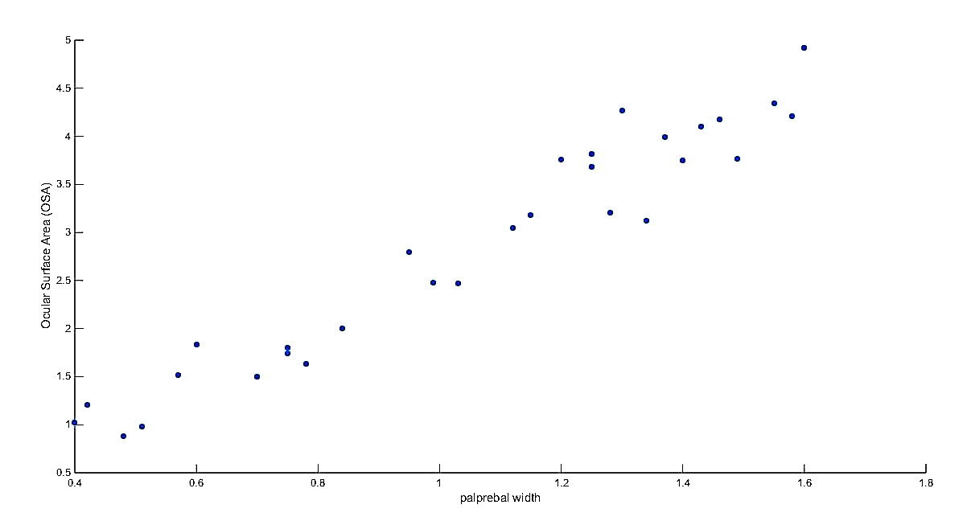
Scatter Plot Example

Slide 8
Scatter Plot Example: Linear Regression
Several observations have identical x values yet different y values.
e.g., x₈=x₉ =0 .75, but y₈ =1.80 and y₉ = 1.74). Thus the value of y is not determined solely by x but also by various other factors.
There is a strong tendency for y to increase as x increases. That is, larger values of OSA tend to be associated with larger values of fissure width—a positive relationship between the variables.
It appears that the value of y could be predicted from x by finding a line that is reasonably close to the points in the plot (the authors of the cited article superimposed such a line on their plot).
In other words, there is evidence of a substantial (though not perfect) linear relationship between the two variables.

Slide 9
Simple Linear Regression Model
For the deterministic model , the actual observed value of y is a linear function of x.
The appropriate generalization of this to a probabilistic model assumes that the expected value of Y is a linear function of x, but that for fixed x the variable Y differs from its expected value by a random amount.
In a simple regression problem (a single x and a single y), the form of the model would be:
y = b₀ + b₁*x
In higher dimensions when we have more than one input (x), the line is called a plane or a hyper-plane. The representation therefore is the form of the equation and the specific values used for the coefficients (e.g. b₀ and b₁ in the above example).

Slide 10

Simple Linear Regression Model
When a coefficient becomes zero, it effectively removes the influence of the input variable on the model and therefore from the prediction made from the model (0 * x = 0).
The values b₀ and b₁ must be chosen so that they minimize the error. If sum of squared error is taken as a metric to evaluate the model, then goal to obtain a line that best reduces the error.

Slide 11


Simple Linear Regression Model
For model with one predictor,
and
Exploring ‘b1’:
If b1 > 0, then x(predictor) and y (target) have a positive relationship. That is increase in x will increase y.
If b1 < 0, then x(predictor) and y (target) have a negative relationship. That is increase in x will decrease y.
Credits: Linear Regression — Detailed View by Saishruthi Swaminathan

Slide 12
Simple Linear Regression Model
Exploring ‘b0’
If the model does not include x=0, then the prediction will become meaningless with only b0.
For example, we have a dataset that relates height(x) and weight(y). Taking x=0(that is height as 0), will make equation have only b0 value which is completely meaningless as in real-time height and weight can never be zero. This resulted due to considering the model values beyond its scope.
If the model includes value 0, then ‘b0’ will be the average of all predicted values when x=0. But, setting zero for all the predictor variables is often impossible.
The value of b0 guarantee that residual have mean zero. If there is no ‘b0’ term, then regression will be forced to pass over the origin. Both the regression co-efficient and prediction will be biased.
Credits: Linear Regression — Detailed View by Saishruthi Swaminathan

Slide 13
Additional Resources:
https://towardsdatascience.com/linear-regression-detailed-view-ea73175f6e86
http://www.stat.yale.edu/Courses/1997-98/101/linreg.htm

Slide 14
Week | Covid Cases in thousands
0 | 0.4
1 | 0.56
2 | 0.96
3 | 1.61
4 | 2.59
5 | 3.35
(Xi-mean(x))^2 | (yi-mean(y))^2 | mul(col 3 and col 4)
6.25 | 1.388469 | 7.638469
16 | 6.4009 | 22.4009
14.44 | 6.948496 | 21.3885
14.0625 | 3.674122 | 17.73662
16 | 0.388711 | 16.38871
25 | 0.000374 | 25.00037
110.5536
91.752

Slide 15

What is clustering?
Clustering: the process of grouping a set of objects into classes of similar objects.
Objects within a cluster should be similar.
Objects from different clusters should be dissimilar.

Slide 16
k-means Clustering
k-means is a partitional clustering algorithm
Let the set of data points (or instances) D be {x₁, x₂, …, x_{n}}, where x_{i} = (x_{i1}, x_{i2}, …, x_{ir}) is a vector in a real-valued space x ⊆ R^{r}, and r is the number of attributes (dimensions) in the data.
The k-means algorithm partitions the given data into k clusters.
Each cluster has a cluster centre, called centroid.
k is specified by the user

Slide 17
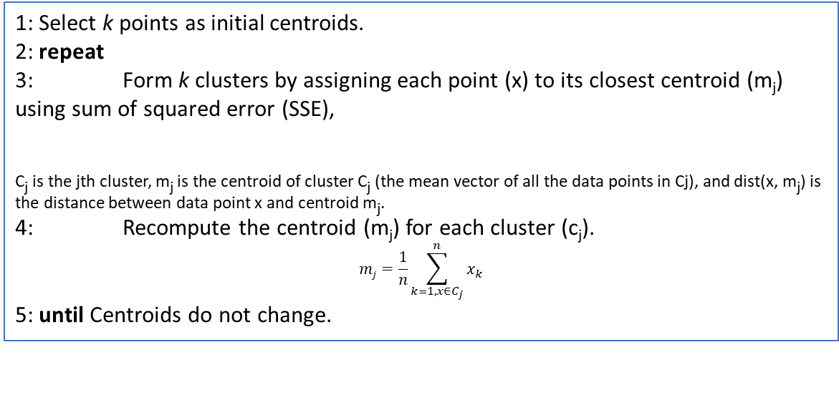
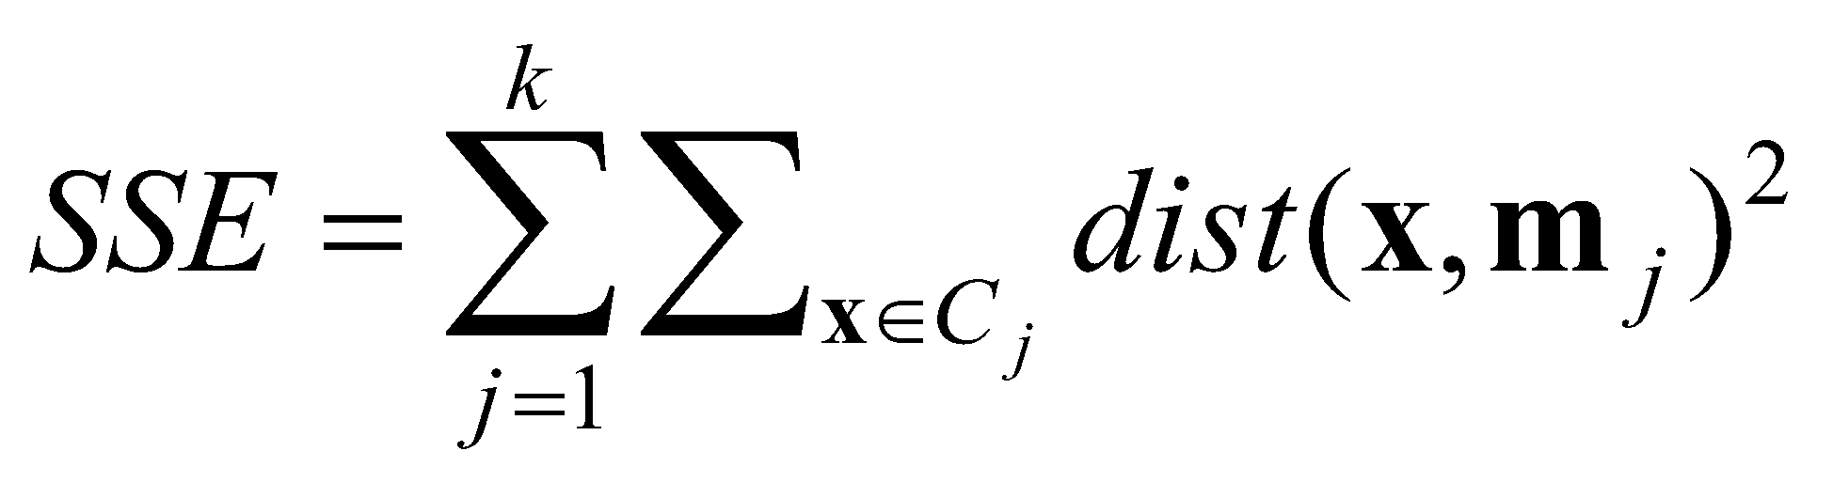
k-means algorithm
Randomly choose k data points (seeds) to be the initial centroids or cluster centers.
Assign each data point to the closest centroid
Re-compute the centroids using the current cluster memberships.
Repeat the assignment (step 2) and update the centroids (step 3) until centroids remain same or no chances in clusters.
Algorithm: k-means clustering algorithm

Slide 18
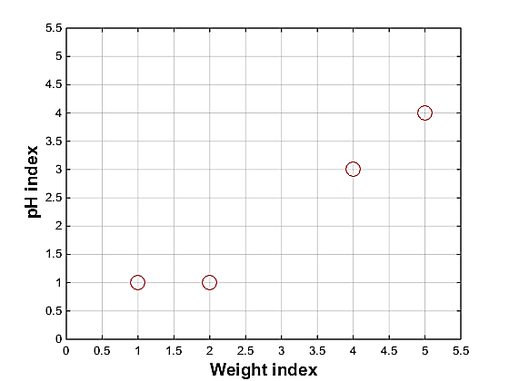
Example of k means:
Problem: Suppose we have 4 types of medicines and each has two attributes (pH and weight index). Our goal is to group these objects into k=2 group of medicine.
Medicine | Weight | pH-index
A | 1 | 1
B | 2 | 1
C | 4 | 3
D | 5 | 4

Slide 19
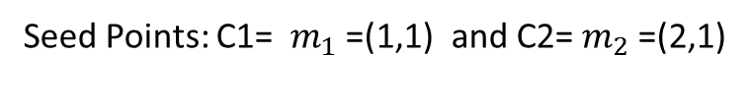
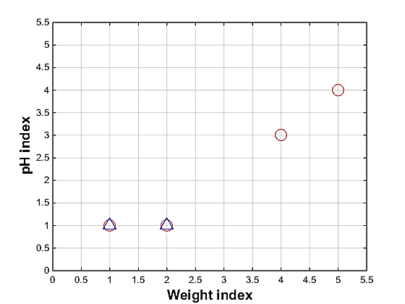










Example of k-means: iteration 1 Step 1: Use initial seed points for partitioning.

Slide 20
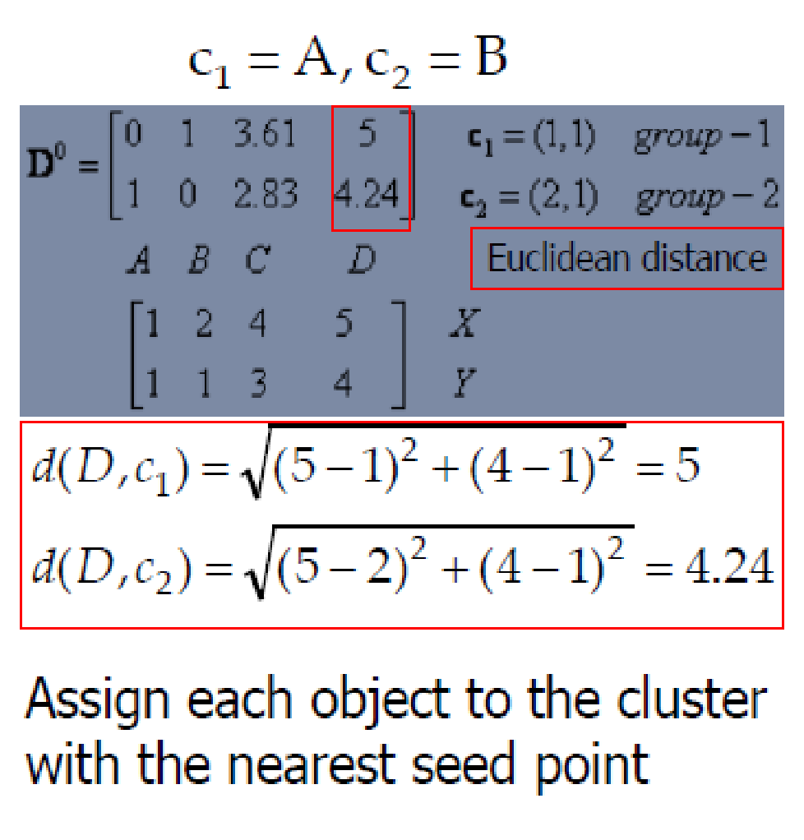
Example of k-means: iteration 1
Step 1: Use initial seed points for partitioning.
Seed Points:
Assign each object to the cluster with the nearest seed point (mean).

Slide 21
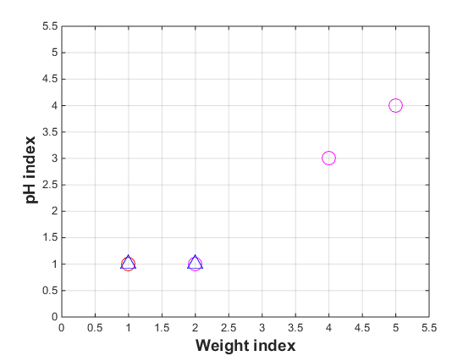
Example of k-means: iteration 1
Step 2: Renew membership based on new centroids..
Seed Points:
Assign each object to the cluster with the nearest seed point (mean).

Slide 22
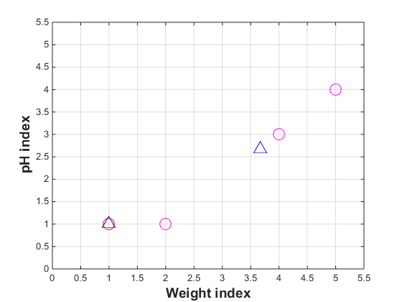
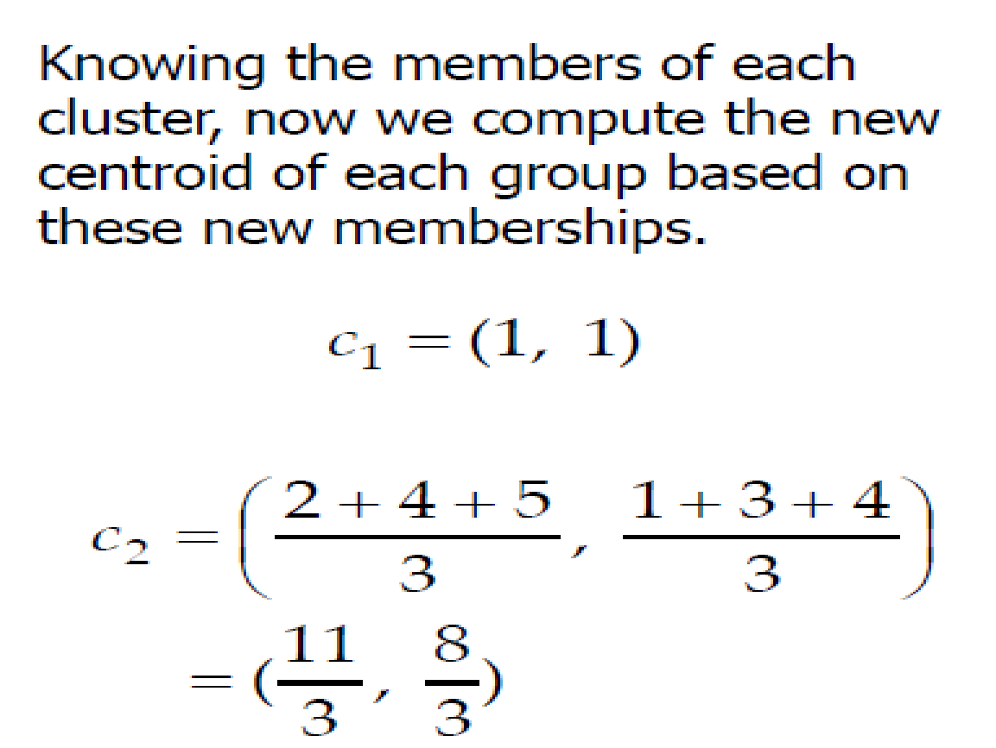
Example of k-means: iteration 1
Step 3: Compute new centroids of the current partition.
Knowing the members of each cluster, compute the new centroid for each cluster based on these new membership assignment.
=(3.66, 2.66)

Slide 23
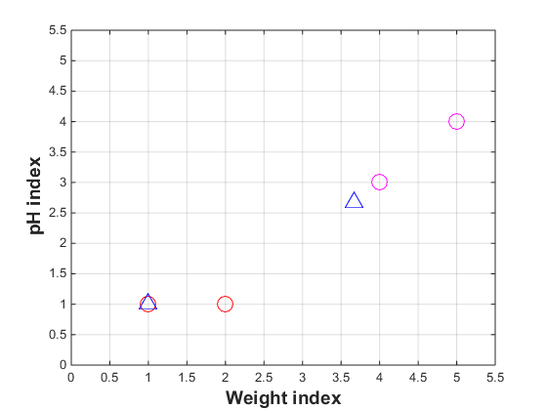
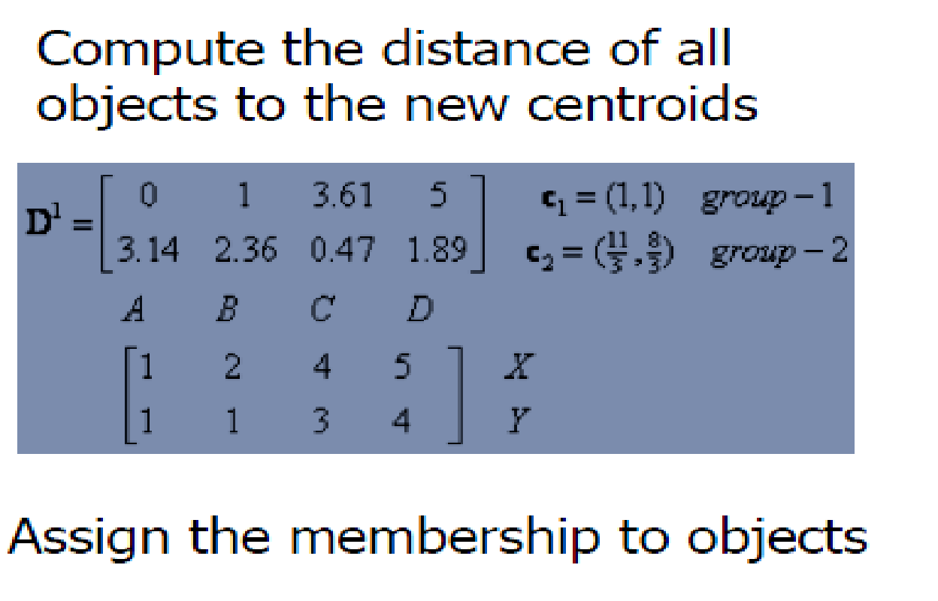
Example of k-means: iteration 2
Step 2: Renew membership based on new centroids.
Compute the distance of all objects to the new centroids.
Assign each object to the cluster with the nearest centroid.

Slide 24
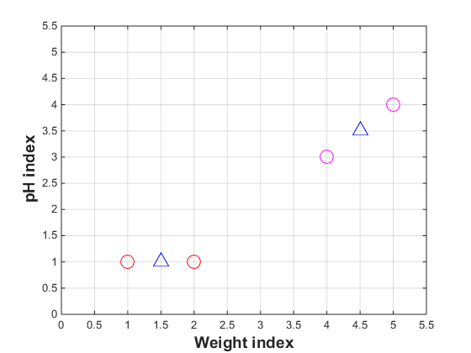
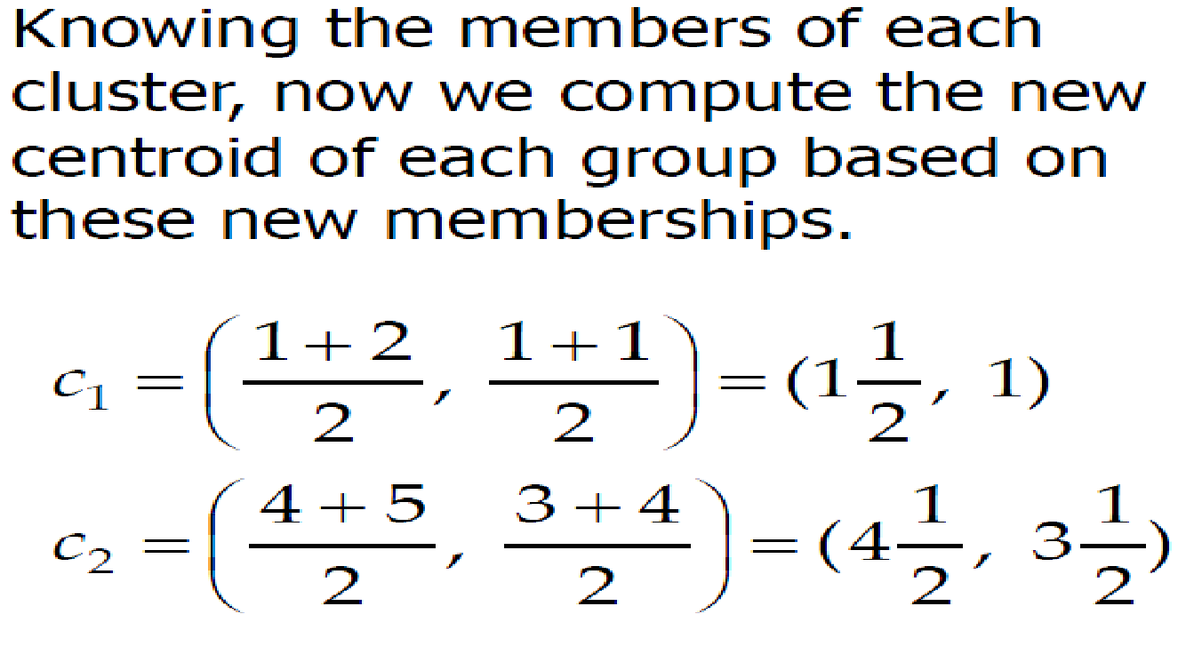
Example of k-means: iteration 2
Step 3: Compute new centroids of the current partition.
Knowing the members of each cluster, compute the new centroid for each cluster based on these new membership assignment.

Slide 25
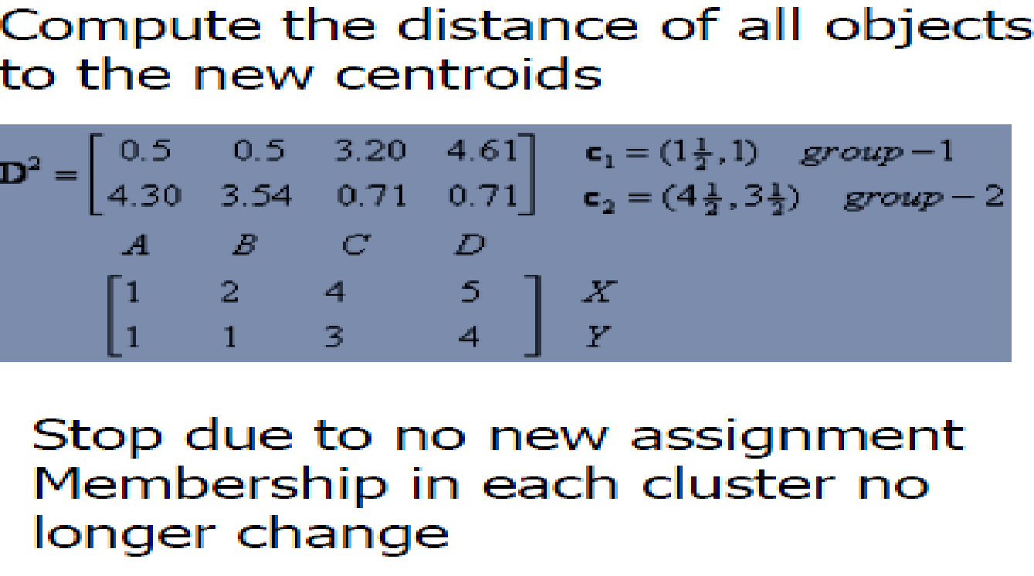
Example of k-means: iteration 3
Step 3: Repeat the first two steps until its convergence.
Compute the distance of all objects to the new centroids.
Assign each object to the cluster with the nearest centroid.
Knowing the members of each cluster, compute the new centroid for each cluster based on these new membership assignment.
Since there is no change in cluster assignments and centroids the algorithm terminates.

Slide 26
Applications of k-means clustering
Behavioural segmentation:
Inventory categorization:
Sorting sensor measurements:
Image Segmentation

